Slide 1
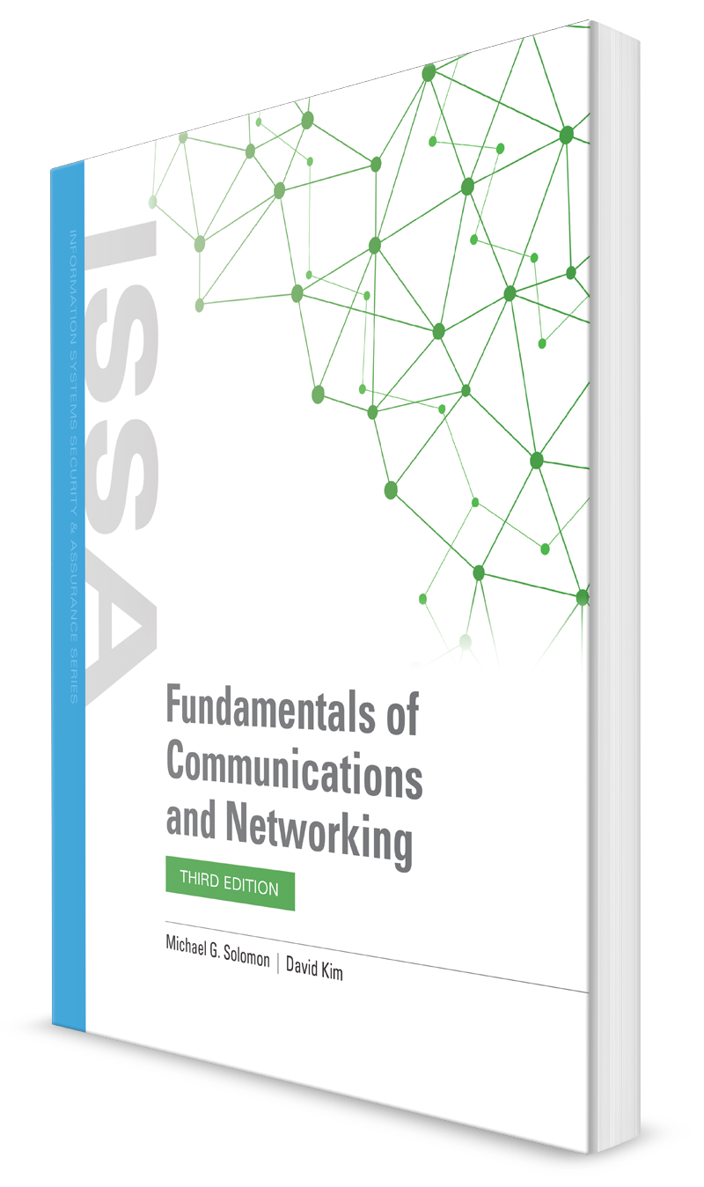
The Network and Transport Layers
CHAPTER 5

Slide 2
Learning Objective(s) and Key Concepts
Learning Objective(s)
Key Concepts
Differentiate between the standards, specifications, technologies, and infrastructure that drive current LAN connectivity.
The Network and Transport Layers of the OSI model
Internet Protocol (IP)
IP device addressing using IPv4 and IPv6
IP-based communications
Connectionless versus connection-oriented communications

Slide 3
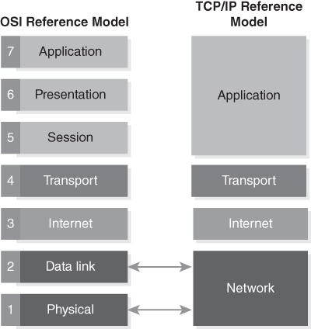
Network and Transport Layers
FIGURE 5-1 OSI model compared to the TCP/IP model.
Notes:
OSI Network Layer is responsible for sending packets across different networks
OSI Transport Layer handles end-to-end message delivery
These layers correspond to the Internet and Transport Layers in the TCP/IP Reference Model.

Slide 4
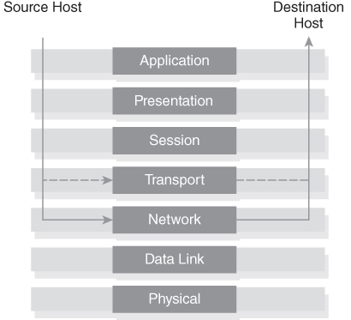
The OSI Network Layer and Transport Layer
FIGURE 5-2 The OSI Network Layer and Transport Layer.

Slide 5
Network Layer: OSI Layer 3
Provides network addressing for packets
Provides and supports switching and routing technologies to direct packets to their destinations
Is the first layer that addresses issues with how to get packets from the source to the destination
Supports creating virtual circuits (predefined paths between two computers)
Protocols that operate at OSI Layer 3 include:
Internet Protocol (IP)
Internet Control Message Protocol (ICMP)
Internet Protocol Security (IPSec)
AppleTalk
Notes:
RFC 791 – IP
ICMP – ping

Slide 6
Transport Layer: OSI Layer 4
Provides transparent and reliable data transfer between computers
Accepts data from the upper layers and handles the details of getting the data to the destination computer
Services provided include:
Flow control
Fragmentation/reassembly
Error control
Acknowledgment of delivery
Protocols that operate at OSI Layer 4 include:
Transmission Control Protocol (TCP)
User Datagram Protocol (UDP)
Stream Control Transmission Protocol (SCTP)
Notes:
TCP - BGP – Border gateway protocol → connection oriented (must be reliable)
UDP – DNS + DHCP → connection less

Slide 7
The Internet Protocol
Primary protocol that relays packets across most of today’s diverse networks
Provides packet routing and host identification to deliver packets to their destinations
Treats all packets, also called datagrams, separately
Each packet contains a header with the destination’s IP address

Slide 8
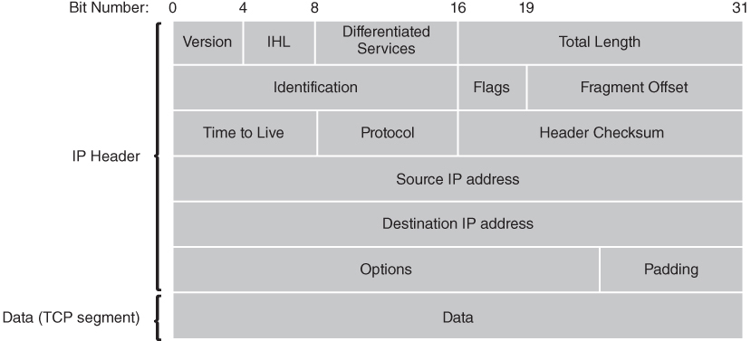
IPv4 Packet Header
FIGURE 5-3 IPv4 packet header.

Slide 9
IPv4 Packet Header
Version—A 4-bit value that signifies which IP version is being used, such as version 4 for IPv4.
Addressing—Each IP header contains 32-bit addresses that identify the source and destination hosts.
Intermediate routers that use these addresses choose a path through the network for the packet.
Fragmentation—The IP software may chop packets into smaller packets.
This process is called fragmentation.
Fragmentation allows computers to send large packets across a network that can handle only smaller packets.
The source computer fragments packets, and the destination computer reassembles packets.
Both processes occur transparently.

Slide 10
IPv4 Packet Header
Packet timeouts—IP adds a Time To Live (TTL) value to each packet header.
Each router that handles the packet decrements the TTL value.
If TTL reaches zero, the current router drops the packet.
This protection mechanism keeps packets from following circular paths and flooding a network.
Type of service—IP allows software to prioritize network traffic.
Each IP packet contains header data that labels the packet with a type of service.
Network devices can use these labels to handle packets with a higher or lower priority.
Notes:
Prioritize voice and video since they take more bandwidth

Slide 11
IPv4 Packet Header
Additional features—IP supports several optional features, including:
Source routing—Allows the source to set requirements on the path the packet takes through the network
Record route—Traces the route a packet takes
Security labels—Assign security features label to packets

Slide 12
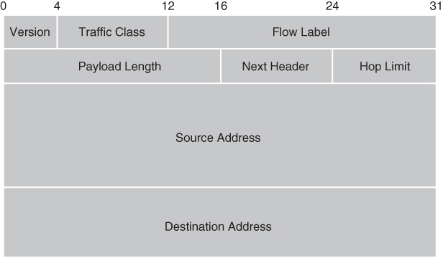
IPv6 Packet Header
FIGURE 5-4 IPv6 packet header.

Slide 13
IPv6 Packet Header
IPv6 introduced a more streamlined packet format design.
IPv6 provides the following services:
Version—A 4-bit value that signifies which IP version is being used.
For IPv6, this value is 6.
Traffic class—An 8-bit field used by source hosts and forwarding routers to distinguish classes or priorities for IPv6 packets.
Flow label—IPv6 allows sources to designate special handling by routers, such as nondefault quality of service (QoS) or real-time applications or service.
Addressing—Each IP header contains 128-bit addresses that identify the source and destination hosts.
Intermediate routers that use these addresses choose a path through the network for the packet.

Slide 14
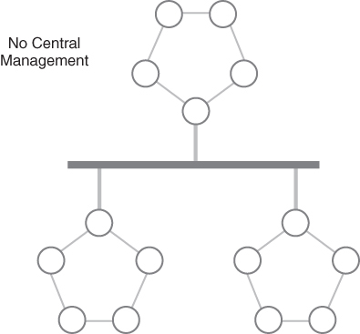
The Internet Protocol—Decentralization
IP networks are decentralized and dynamic
Packet might not reach its destination node or, if it reaches its destination, might be different from the original packet
A network node can use a checksum to tell if a packet header has changed
FIGURE 5-5 Decentralized IP network.

Slide 15
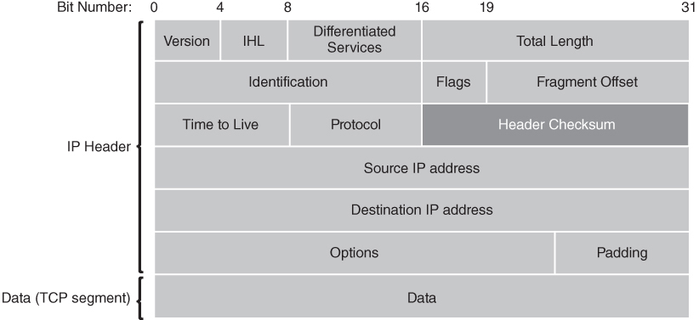
IPv4 Header Checksum
FIGURE 5-6 IPv4 Header Checksum.

Slide 16
IPv4 Header Checksum
IPv4 Includes a header checksum, this checksum is altered anytime the header is altered
This obviously adds latency to the processing of this data, but it helps check for errors
IPv6 does not include checksums – this was done for increased performance

Slide 17
IP Addressing: IPv4 versus IPv6
Devices on IP-based networks, like the Internet, need IP addresses
Internet Engineering Task Force (IETF) develops and promotes Internet standards, and publishes IPv4 and IPv6
Internet Assigned Numbers Authority (IANA)
Is responsible for coordinating IP addresses and resources around the world
Reported that it exhausted the primary address pool of IPv4 addresses on February 3, 2011
IPv4 still in primary use; slow transition to IPv6

Slide 18
IPv4
32-bit addresses (4 bytes)
Usually displayed in dot notation
Four separate 8-bit numbers (octets)
Octets separated by periods
Octet value is between 0 and 255
Example: 192.168.0.1
IPv4 networks can be classful or classless
Dynamic Host Configuration Protocol (DHCP)
A standard method for internal devices to request and receive IP addresses and configuration information
Network address translation (NAT) and private IP addresses make it possible to continue using IPv4 well into the future

Slide 19
To access the Internet, one public IP address is needed, but we can use a private IP address in our private network.
The idea of NAT is to allow multiple devices to access the Internet through a single public address.
To achieve this, the translation of a private IP address to a public IP address is required.
Network Address Translation (NAT) is a process in which one or more local IP address is translated into one or more Global IP address and vice versa in order to provide Internet access to the local hosts.
Also, it does the translation of port numbers i.e. masks the port number of the host with another port number, in the packet that will be routed to the destination.
It then makes the corresponding entries of IP address and port number in the NAT table.
NAT generally operates on a router or firewall.

Slide 20
Network Address Translation (NAT) working –
Generally, the border router is configured for NAT i.e the router which has one interface in the local (inside) network and one interface in the global (outside) network.
When a packet traverse outside the local (inside) network, then NAT converts that local (private) IP address to a global (public) IP address.
When a packet enters the local network, the global (public) IP address is converted to a local (private) IP address.
If NAT runs out of addresses, i.e., no address is left in the pool configured then the packets will be dropped and an Internet Control Message Protocol (ICMP) host unreachable packet to the destination is sent.

Slide 21
Why mask port numbers ?
Suppose, in a network, two hosts A and B are connected.
Now, both request for the same destination, on the same port number, say 1000, on the host side, at the same time.
If NAT does only translation of IP addresses, then when their packets will arrive at the NAT, both of their IP addresses would be masked by the public IP address of the network and sent to the destination.
Destination will send replies to the public IP address of the router.
Thus, on receiving a reply, it will be unclear to NAT as to which reply belongs to which host (because source port numbers for both A and B are the same).
Hence, to avoid such a problem, NAT masks the source port number as well and makes an entry in the NAT table.

Slide 22
NAT
Network Address Translation (NAT) Types – There are 3 ways to configure NAT:
Static NAT – In this, a single unregistered (Private) IP address is mapped with a legally registered (Public) IP address i.e one-to-one mapping between local and global addresses. This is generally used for Web hosting.
These are not used in organizations as there are many devices that will need Internet access and to provide Internet access, a public IP address is needed.
Suppose, if there are 3000 devices that need access to the Internet, the organization must buy 3000 public addresses that will be very costly.

Slide 23
NAT
Dynamic NAT – In this type of NAT, an unregistered IP address is translated into a registered (Public) IP address from a pool of public IP addresses.
If the IP address of the pool is not free, then the packet will be dropped as only a fixed number of private IP addresses can be translated to public addresses.
Suppose, if there is a pool of 2 public IP addresses then only 2 private IP addresses can be translated at a given time.
If 3rd private IP address wants to access the Internet, then the packet will be dropped therefore many private IP addresses are mapped to a pool of public IP addresses.
NAT is used when the number of users who want to access the Internet is fixed.
This is also very costly as the organization must buy many global IP addresses to make a pool.

Slide 24
NAT
Port Address Translation (PAT) – This is also known as NAT overload. In this, many local (private) IP addresses can be translated to a single registered IP address.
Port numbers are used to distinguish the traffic i.e., which traffic belongs to which IP address.
This is most frequently used as it is cost-effective as thousands of users can be connected to the Internet by using only one real global (public) IP address.

Slide 25
NAT
Advantages of NAT –
NAT conserves legally registered IP addresses.
It provides privacy as the device’s IP address, sending and receiving the traffic, will be hidden.
Eliminates address renumbering when a network evolves.
Disadvantage of NAT –
Translation results in switching path delays.
Certain applications will not function while NAT is enabled.
Complicates tunneling protocols such as IPsec.
Also, the router being a network layer device, should not tamper with port numbers(transport layer) but it must do so because of NAT.

Slide 26
IPv4 Classful Network Architecture
Addressing architecture created five different types of networks based on their required number of nodes
IP addresses originally organized into five classes: A, B, C, D, and E
A, B, and C used for networks
Each class restricted to a particular IP address range
Range based on number of nodes needed
Maximum number of 4,294,967,296 addresses (2³²)

Slide 27
Classful Network Classes
Class | Leading Bits | Size of Network Field | # of Networks | Number of Nodes | Address Range
A (large) | 0 | 8 | 128 | 16,777,216 | 0.0.0.0 to 127.255.255.255
B (medium) | 10 | 16 | 16,384 | 65,536 | 128.0.0.0 to 191.255.255.255
C (small) | 110 | 24 | 2,097,152 | 256 | 192.0.0.0 to 223.255.255.255
D (multicast) | 1110 | N/A | N/A | N/A | 224.0.0.0 to 239.255.255.255
E (future use) | 1111 | N/A | N/A | N/A | 240.0.0.0 to 255.255.255.255
Notes:
Homes usually use Class C network classes.

Slide 28
IPv4 CIDR and Subnet Mask
CIDR
Replacement for classful network architecture
Temporary solution for IP address shortage address format
Is similar to the IP address dot notation
Networks are split into groups of IP addresses called CIDR blocks
Subnet Mask
Is a binary number that contains all 1’s in the leftmost prefix length positions
Subnet mask for the CIDR address block 168.12.0.0/16 would be:
11111111.11111111.00000000.00000000
Helps determine which network a given IP address belongs to by indicating which part of an IP address denotes the network and which part denotes the host
Notes:
OR AND gates
A bunch of people live in the same zip codes, but have different physical addresses.
Zip code = network, physical address = IP

Slide 29
The IANA now manages network addressing using Classless Inter-Domain Routing(CIDR).
CIDR allows the IANA to segment any address space to define larger or smaller networks as needed
This new strategy gives the IANA far more flexibility to allocate networks of virtually any size without wasting large blocks of IP addresses
Classful networks were based on fixed network identifiers.
CIDR uses Variable Length Subnet Masking (VLSM) to allow networks to be fragmented into any size subnetwork.
CIDR defines networks using IP address prefixes.
The IANA can allocate a network that consists of any number of binary bits to form the network’s address.
A CIDR block is a group of addresses that share the same prefix

Slide 30
Classful networks defined only a limited number of network prefixes based on network class.
CIDR allows network prefixes of any length, up to the IPv4 address size.
The CIDR address format is similar to the IP address dot notation.
A network’s address is the base IP address in dot notation, followed by the number of bits in the prefix.
The two values are separated by a slash character (/).

Slide 31
IPv4 Private Networks
Contains private IP addresses
Are not routable
Purpose of private IP addresses is to allow organizations to assign their own device IP addresses from the private network ranges
Network address translation (NAT) maps internal addresses to public routable addresses
Port address translation (PAT) allows you to share a single, public-facing IP address with a range of internal, private IP host addresses
Private Address Ranges
172.16.0.0 to 172.31.255.255
192.168.0.0 to 192.168.255.255
10.0.0.0 to 10.255.255.255

Slide 32
Resolving Addresses
Address resolution is the process of finding an IP address for a host name
Domain Name System (DNS) is a hierarchical naming system that allows organizations to associate host names with IP address names spaces
Example: amazon.com > 72.21.211.176
DNS
Servers store these associations and make the tables available for network users
Servers keep up with the changing host names and make it easy to react to any organization that changes its IP addresses
Is crucial to making the Internet a usable network

Slide 33
Resolving Addresses
There are 4 DNS servers involved in loading a webpage:
DNS recursor - The recursor can be thought of as a librarian who is asked to go find a particular book somewhere in a library.
The DNS recursor is a server designed to receive queries from client machines through applications such as web browsers.
Typically the recursor is then responsible for making additional requests in order to satisfy the client’s DNS query.

Slide 34
Resolving Addresses
Root nameserver -
The root server is the first step in translating (resolving) human readable host names into IP addresses.
It can be thought of like an index in a library that points to different racks of books - typically it serves as a reference to other more specific locations.
TLD nameserver -
The top level domain server (TLD) can be thought of as a specific rack of books in a library.
This nameserver is the next step in the search for a specific IP address, and it hosts the last portion of a hostname (In example.com, the TLD server is “com”).

Slide 35
Resolving Addresses
Authoritative nameserver -
This final nameserver can be thought of as a dictionary on a rack of books, in which a specific name can be translated into its definition.
The authoritative nameserver is the last stop in the nameserver query.
If the authoritative name server has access to the requested record, it will return the IP address for the requested hostname back to the DNS Recursor (the librarian) that made the initial request.

Slide 36
Authoritative DNS server and a recursive DNS resolver
The recursive resolver is the computer that responds to a recursive request from a client and takes the time to track down the DNS record.
It does this by making a series of requests until it reaches the authoritative DNS nameserver for the requested record (or times out or returns an error if no record is found).
Luckily, recursive DNS resolvers do not always need to make multiple requests in order to track down the records needed to respond to a client; caching is a data persistence process that helps short-circuit the necessary requests by serving the requested resource record earlier in the DNS lookup.

Slide 37
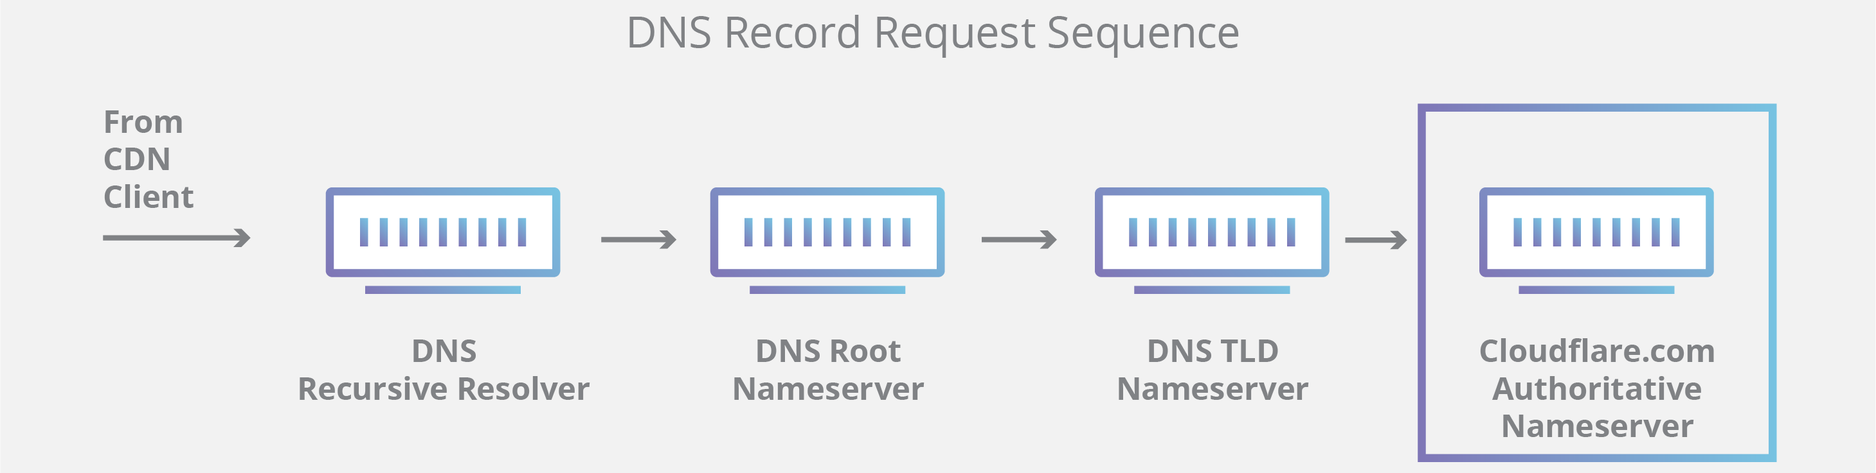
Authoritative DNS server and a recursive DNS resolver

Slide 38
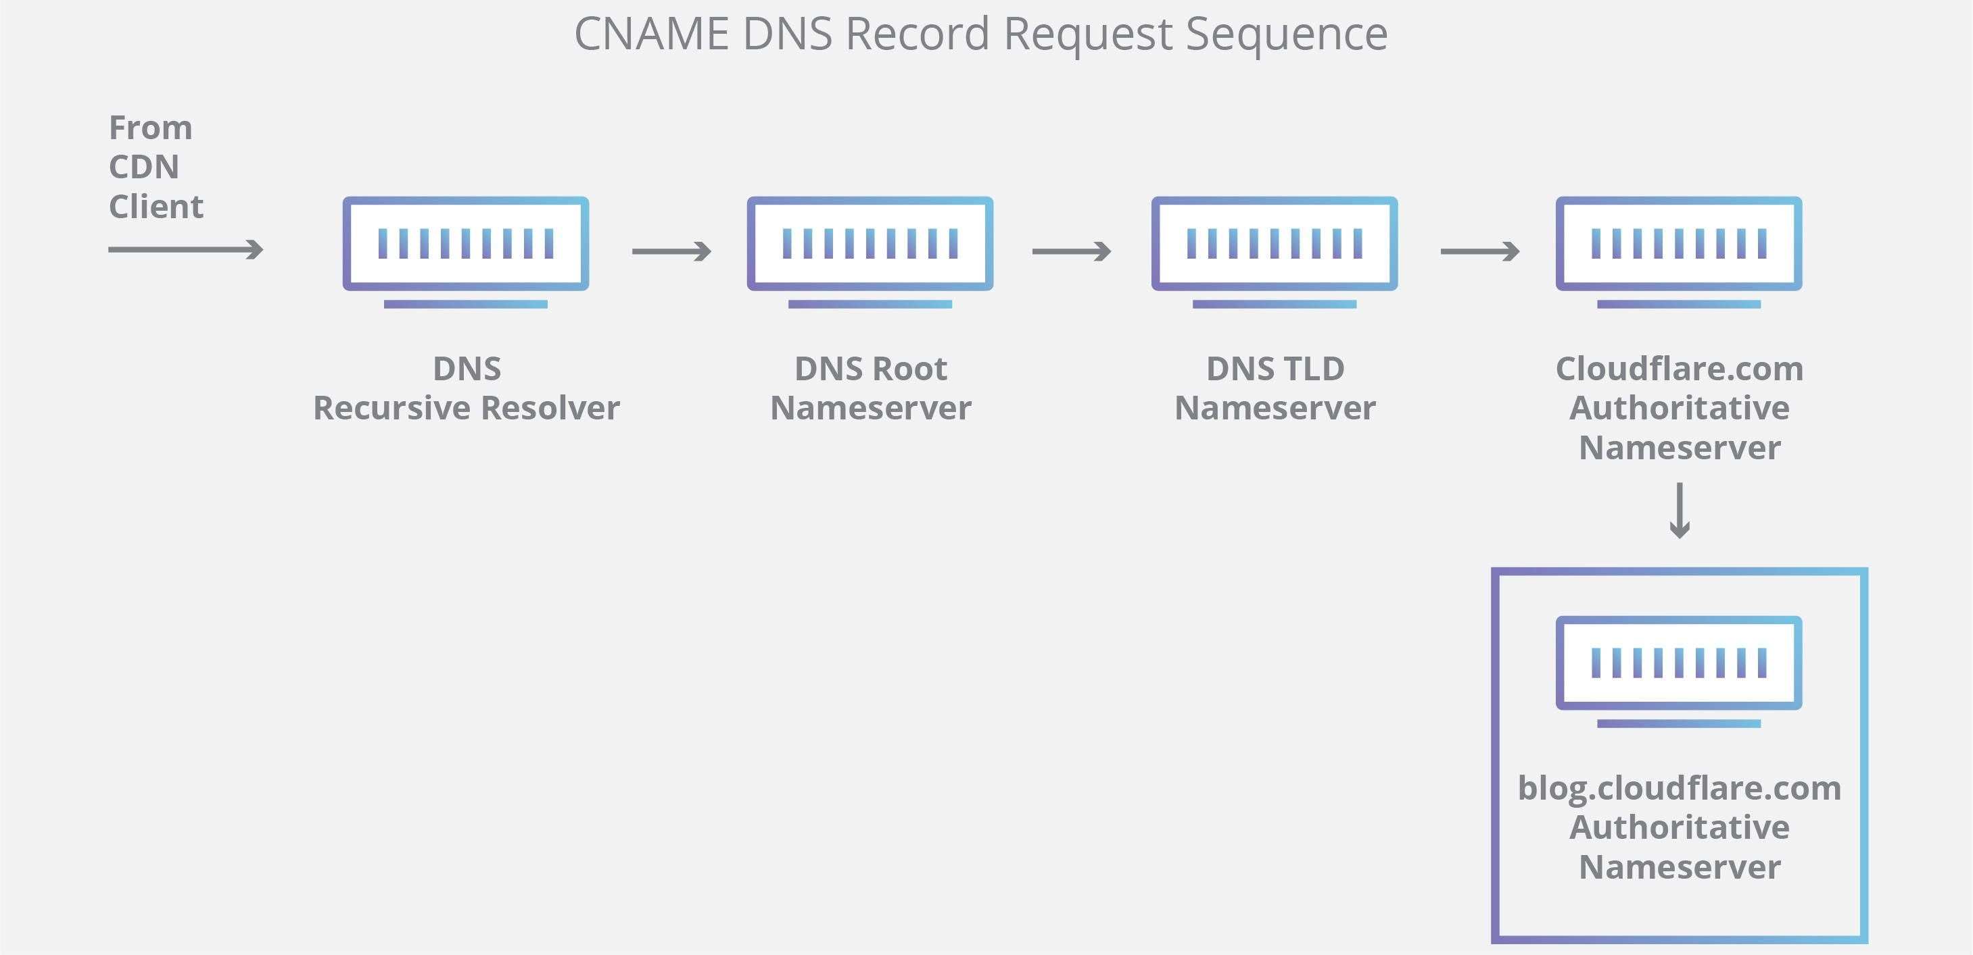
Authoritative DNS server and a recursive DNS resolver
It’s worth mentioning that in instances where the query is for a subdomain such as foo.example.com or blog.cloudflare.com, an additional nameserver will be added to the sequence after the authoritative nameserver, which is responsible for storing the subdomain’s CNAME record.

Slide 39
DNS Lookup
A user types ‘example.com’ into a web browser and the query travels into the Internet and is received by a DNS recursive resolver.
The resolver then queries a DNS root nameserver (.).
The root server then responds to the resolver with the address of a Top Level Domain (TLD) DNS server (such as .com or .net), which stores the information for its domains. When searching for example.com, our request is pointed toward the .com TLD.
The resolver then makes a request to the .com TLD.
5. The TLD server then responds with the IP address of the domain’s nameserver, example.com.
6. Lastly, the recursive resolver sends a query to the domain’s nameserver.
7. The IP address for example.com is then returned to the resolver from the nameserver.
8. The DNS resolver then responds to the web browser with the IP address of the domain requested initially.

Slide 40
IPv6 (1 of 2)
Primary motivation for creating IPv6 was to increase the network address space
Uses 128-bit addresses
Increases address size from the IPv4 32 bits to 128 bits
Maximum number of 2¹²⁸ addresses (> 340 undecillion)
1 undecillion = 1,000,000,000,000,000,000,000,000,000,000,000,000

Slide 41
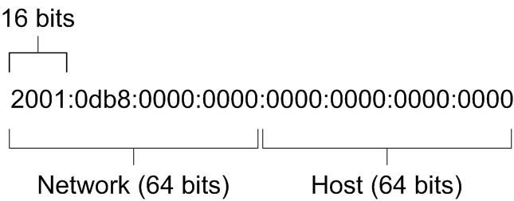
IPv6 (2 of 2)
Eight groups of 4 hexadecimal numbers
First 64 bits identify network
Last 64 bits identify host (based on MAC address)

Slide 42
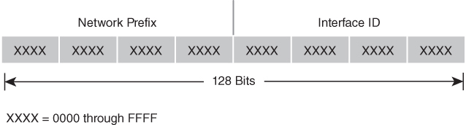
IPv6 Address Format
FIGURE 5-7 IPv6 address format.

Slide 43
IPv6 Address Compression
Drop leading 0s in each group
2001:0db8:0000:0000:0000:0053:0000:0004
becomes
2001:db8:0:0:0:53:0:4
Replace the first group of 0s with ::
2001:0db8:0000:0000:0000:0053:0000:0004
becomes
2001:db8::53:0:4
Only one set of :: can exist in an address

Slide 44
IPv6 Network Methodologies
Unicast—Sending a packet to a single destination
Anycast—Sending a packet to the nearest node in a specified group of nodes
Multicast—Sending a packet to multiple destinations
Broadcast address sends a packet to a complete range of IP addresses

Slide 45
IPv4 to IPv6
Dual IP stack operating systems support both IPv4 and IPv6 using two separate network stacks for IP
Literal IPv6 addresses
Colon character is a reserved character in network resource identifiers and UNC path names
For network resource identifiers, add square brackets around literal IPv6 addresses
http://[2001:db8::206:0:a80c:52b]:8080
For UNC path names, convert colon characters to dashes and append “.ipv6-literal.net” domain to IPv6 literal addresses
2001:db8::206:0:a80c:52b
would be written as
2001-db8--206-0-a80c-52b.ipv6-literal.net

Slide 46
IP Communications (1 of 2)
When a packet enters its destination network, the network stack needs to know the packet’s local destination.
IPv4 networks use Address Resolution Protocol (ARP) to provide local Media Access Control (MAC) addresses
IPv6 networks use the Neighbor Discovery Protocol (NDP)
It operates at the link layer, and is responsible for gathering various information required for network communication, including the configuration of local connections and the domain name servers and gateways
ARP and NDP make it possible to use IP to transport traffic within local networks and between networks, including those connected to the Internet

Slide 47
IP Communications (2 of 2)
IP networks can exchange nearly any type of data between any two nodes on the network
Types of supported traffic:
Email messages
Telephone calls
Video conferencing
Streaming audio and video
Large file transfers
Real-time data
Instant messages

Slide 48
Connectionless Versus Connection-Oriented Communications
Most direct path to a destination may not be the best route if it’s congested
IP is a connectionless protocol
No notion of a connection between source and destination nodes
Treats each packet separately
Alternative is a connection-oriented protocol
Sets up a connection between the source and destination
Treats each message separately
Layered networking software enables a mix of connectionless and connection-oriented protocols
Can use a connection-oriented protocol at Layer 4 or higher and still use IP for Layer 3

Slide 49
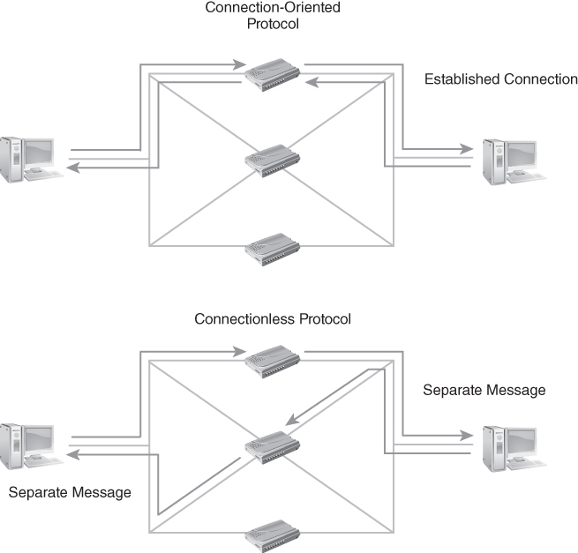
Connection-Oriented and Connectionless Protocols
FIGURE 5-8 Connection-oriented and Connectionless Protocols.

Slide 50
Summary
The Network and Transport Layers of the OSI model
Internet Protocol (IP)
IP device addressing using IPv4 and IPv6
IP-based communications
Connectionless versus connection-oriented communications

